Slide 1


BATCH NO:06
TEEGALA KRISHNA REDDY ENGINEERING COLLEGE
(UGC-Autonomous)
Approved by AICTE, Affiliated by JNTUH, Accredited by NAAC- ‘A’ Grade
Medbowli , Meerpet , Balapur ,Hyderabad, Telangana- 500097
Mob: 9393959597. Email: info@tkrec.ac.in, deanacademics@tkrec.ac.in
DEPARTMENT OF ELECTRONICS AND COMMUNICATION ENGINEERING
IOT BASED SMART SHOE FOR THE BLIND PEOPLE
TEAM MEMBERS :-
22R91A04F4:M.NANDINI
22R91A04K2:P.SURESH
22R91A04H8:P.THARUN
22R91A04J7:P.NAVEEN
GUIDED BY:-
Mrs. S. PRATHYUSHA
(ASSISSTANT PROFESSOR)

Slide 2
Table of Contents
1. OBJECTIVE
2.ABSTRACT
3.BLOCK DIAGRAM
4.METHODOLOGY
5.ADVANTAGES AND APPLICATIONS
6.EXPECTED RESULT

Slide 4
OBJECTIVES
The goal of this initiative is to create an Electronic Traveling Aid (ETA) kit that will assist blind people in navigating clear paths. The shoe is set to this ETA.
This system includes a buzzer, an ultrasonic sensor, and a microcontroller and is designed to provide overall measures for object recognition, human detection, and real-time assistance.
In this case, a user-alerting ultrasonic monitor was used to measure the distance between the user and the obstruction

Slide 5
Existing System
Traditional aids include white canes and guide dogs.
Limited range and no real-time voice feedback.
Devices like smart glasses are expensive and not always comfortable.
Most existing systems lack multi-directional obstacle detection.

Slide 6
Problem Identification
• Visually impaired people struggle with navigation, especially in unfamiliar environments.
• Existing aids don’t provide multi-directional feedback or instant alerts.
• There is a need for a low-cost, wearable, and intelligent navigation aid.

Slide 7
ABSTRACT
The IoT-based smart shoe is designed to assist visually impaired individuals in navigating their surroundings safely and independently.
It incorporates ultrasonic sensors to detect obstacles, a microcontroller to process data, and vibration motors or audio alerts to notify users of potential hazards.
Additionally, GPS and IoT connectivity enable real-time location tracking and emergency assistance. The smart shoe enhances mobility, safety, and independence by providing immediate feedback to the user.
It also allows caregivers to monitor the user's location in real-time. The system reduces dependency on external assistance, increases confidence, and offers a cost-effective solution for blind individuals.
Experimental results demonstrate that the smart shoe effectively detects obstacles and improves independent navigation.
INDEX TERMS: IOT, Micro-controller, Ultrasonic sensor, Obstacle Detection, Smart shoe

Slide 8
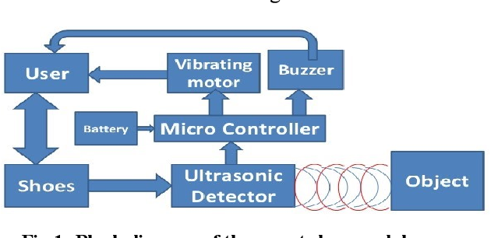
BLOCK DIAGRAM

Slide 9
METHODOLOGY
For developing an IoT-based smart shoe for blind people follows a structured approach. First, the problem is identified by understanding the mobility challenges faced by visually impaired individuals and the need for a hands-free navigation aid.
Next, the system is designed by selecting essential components such as ultrasonic sensors for obstacle detection, a microcontroller for processing data, vibration motors or speakers for user alerts, a GPS module for location tracking, and IoT connectivity for remote monitoring.
The hardware integration phase involves embedding these components into the shoe and connecting them to the microcontroller. Meanwhile, the software is developed to process sensor data, trigger alerts, and enable GPS-based tracking.
The system is then tested in various real-world environments to calibrate sensor sensitivity and optimize response timing.
User feedback is gathered to improve the design, focusing on comfort, battery efficiency, and usability.
Finally, the smart shoe is deployed for practical use, with potential integration into smart city infrastructure and other assistive technologies to enhance accessibility and safety for visually impaired individuals.

Slide 10
Advantages and Applications
Advantages:
Enhanced Mobility – Helps visually impaired individuals navigate safely without external assistance.
Real-Time Obstacle Detection – Ultrasonic sensors detect obstacles and alert the user through vibrations or sound.
Increased Safety – Reduces the risk of collisions, falls, and accidents in unfamiliar environments.
IoT Connectivity – Enables remote monitoring and emergency alerts for caregivers.
Hands-Free Operation – Unlike canes or handheld devices, the smart shoe allows free movement without extra effort.
Applications:
Personal Navigation – Helps visually impaired individuals move safely in indoor and outdoor environments.
Obstacle Detection – Alerts users about obstacles on footpaths, stairs, and uneven surfaces.
Emergency Assistance – Sends alerts to caregivers or emergency services in case of distress.
Indoor Navigation – Useful in malls, offices, hospitals, and other complex indoor spaces.
Sports and Recreation – Helps blind individuals participate in outdoor activities like jogging or walking.

Slide 11
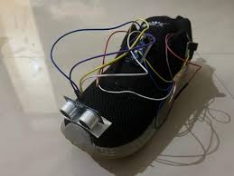
EXPECTED RESULT

Slide 12
Thank you...

